Slide 1


Slide 2

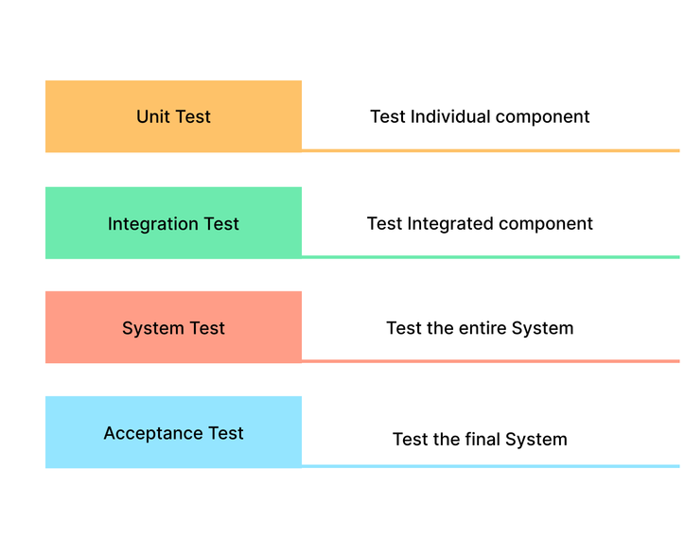
Introduction
Mainly there are 4 testing tiers in software testing

Slide 3
Unit Testing
Unit testing involves the testing of each unit or an individual component of the software application.
The first level of functional testing.
The main aim behind unit testing is to validate unit components with its performance.

Slide 4
Integration Testing
The second level of software testing process.
In this testing, units or individual components of the software are tested in a group.
Unit testing uses modules for testing purpose, and these modules are combined and tested in integration testing.

Slide 5
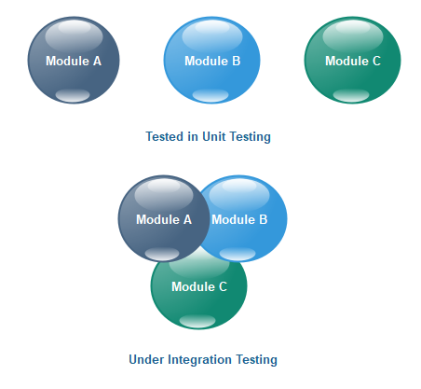

Slide 6
Types of Integration Testing
Big Bang
Incremental Testing

Slide 7
Big Bang
Big Bang is an integration testing in which all modules are combined together and tested once.
Incremental Testing
2 types
Top - down approach
Bottom -up approach

Slide 8
Top - down approach
Top - down approach performs testing for high-level components first ,then move to lower-level components.
Bottom -up approach
Bottom -up approach performs testing for low-level components first, then move to higher-level components.

Slide 9
System Testing
The third level of software testing.
System testing is used to test the software's functional and non-functional requirements.
System testing is used to examine the entire working of an integrated software computer system against requirements.

Slide 10
User Acceptance Testing
The last and fourth level of software testing.
User acceptance testing (UAT) is done by the customer before accepting the final product.

Slide 11
Conclusion
A level of software testing is a process where every unit or component of a software or system is tested.
The main reason for implementing the levels of testing is to make the software testing process efficient and easy to find all possible test cases at a specific level.

Slide 12
THANK YOU

